Slide 1
Female Reproductive system Organs
Prof. Aranjan Lionel Karunanayake MBBS, DM, DOH&S, Dip.Tox, Dipin. Coun, D.Sp.Med, FSS, MBASEM (UK), MSC.SEM (UK)

Slide 2
Objectives for organs-
Student should be able to
describe the structure (macroscopy and microscopy).
describe the blood supply and nerve supply.
describe the lymphatic drainage and its clinical importance.
describe the supports if relevant.
describe the development.
identify organs, parts of organs in pelvic and perineal regions in the models.
identify vessels and nerves in pelvic and perineal regions in the models
describe the microscopic changes which occur at puberty, pregnancy, lactation and menopause if relevant.

Slide 3
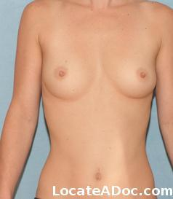


Slide 4
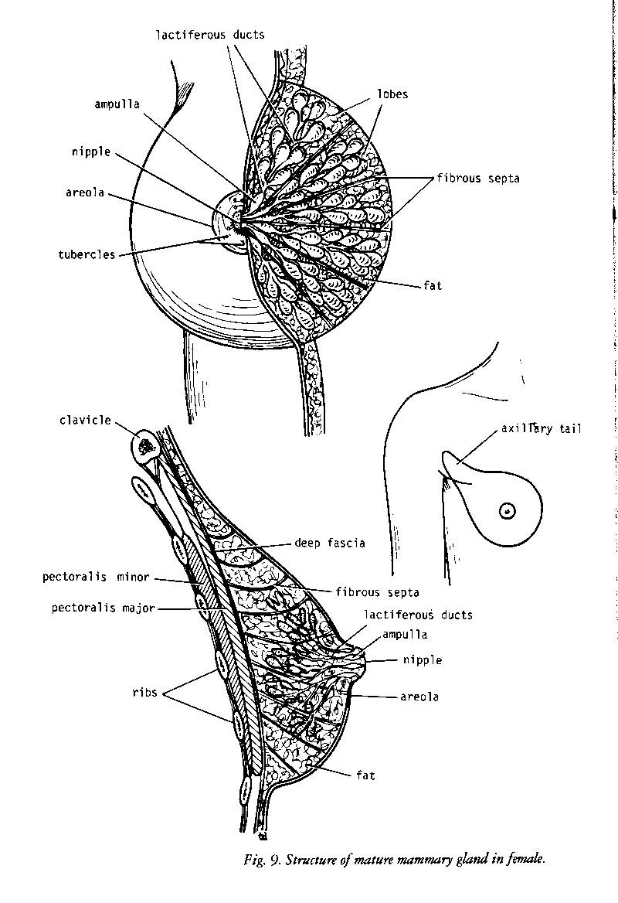
Breast-
It is a modified sweat gland.
It has 15-20 lobes radiating from the nipple. Lobes are separated from fibrous septa. Each lobe has a duct which opens on the summit of the nipple. Fibrous septa extend from the dermis to the deep fascia in front of pectoralis major.
Glands are similar in males and immature females. Small nipples and areolar are fully formed.
At puberty in females-
Enlarges, hemispherical in shape, ducts elongate, increased deposition of fat.

Slide 5
Extent –
Lateral margin of sternum – mid axillary line
2nd rib – 6th rib
Greater part – superficial fascia
Axillary tail – deep fascia.
Blood supply –
Internal thoracic artery – perforating arteries
Posterior Intercostal arteries of 2nd, 3rd, 4th – perforating arteries
Axillary artery – lateral thoracic and acromio thoracic artery, superior thoracic
Veins correspond to the arteries.

Slide 6
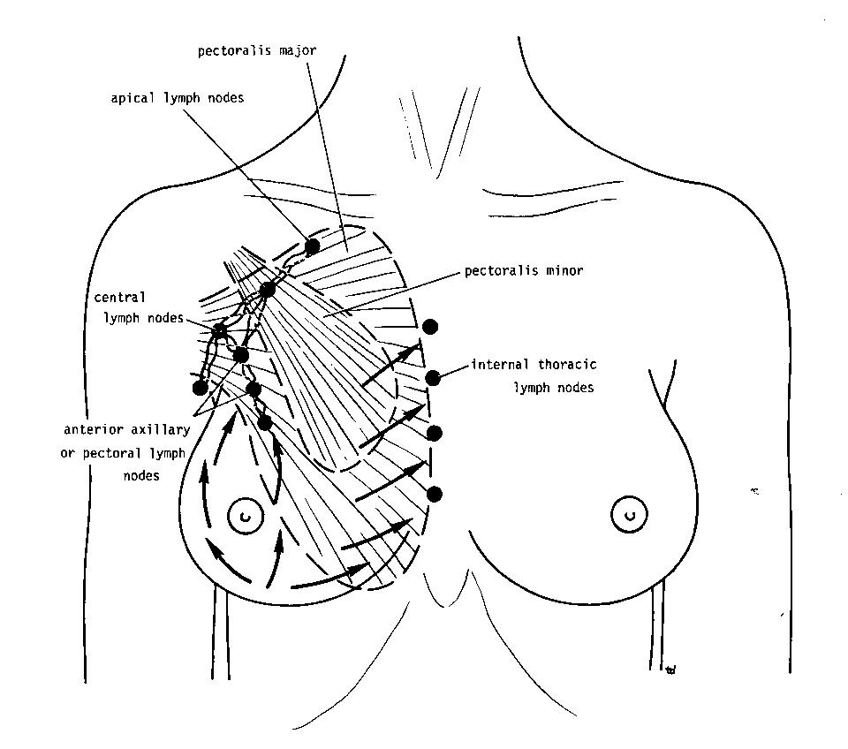
Lymphatic drainage-
Superficial lymph vessels drain skin except nipple and areolar.
Upper part – supraclavicular and few to deltapectoral
Medial part – internal mammary
Lateral part – anterior pectoral
Lower part – subperitoneal plexuses
Deep lymph vessels drain the parenchyma, nipple and areolar.
They first drain into anterior, interpectoral, posterio and lateral nodes. From there they drain into central and apical nodes.
Some peripheral part of upper quadrant can drain directly into apical nodes.
Some deep nodes drain into intercostal nodes.

Slide 7
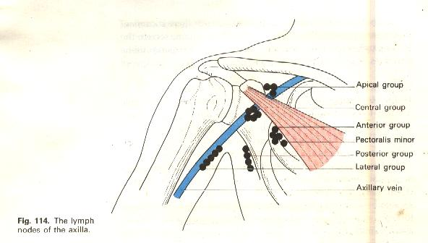
Few lymph from the base communicate with lymph vessels in the rectus sheath and sub peritoneal lymph plexus.
Depending on the relation to pectoral muscles can be classified into-
Group 1- anterior, posterior lateral
Group 2 – central, inter pectoral
Group 3 – apical

Slide 8
All axillary nodes drain through Apical nodes.
From apical nodes – right and left subclavian lymph trunks
Right side – right jugular trunk - subclavian vein
Left side – thoracic duct – brachiocephalic or subclavian vein..
Malignancy of breast can spread to – opposite breast, opposite axillary nodes, groin lymph nodes, cervical lymph nodes and peritoneal lymphatics.
Spread of carcinoma – lymphatics, veins, peritoneal cavity.

Slide 9
Development –
Develops as an invagination of chest wall ectoderm.
Site of invagination – everts – nipple.
Puberty – alveoli sprouts from ducts and considerable fatty infiltration of tissues.
Pregnancy – tremendous development of alveoli
Menopause – glandular tissues atrophy.

Slide 10
Clinical features –
Developmental abnormalities – nipple fails to evert, supernumery nipples, absent breasts
Abscess – opened by a radial incision, can rupture from one fascial compartment to the other.
Dimpling of skin – fibrous contraction of fibrous ligament
Nipple retraction – involvement of milk ducts by a scirrhous tumour.
Simple mastectomy – only breast tissues
Extended simple mastectomy – breast, axillary fat and nodes.
Radical mastectomy – breast, lymph nodes, skin around the tumour, pec major and pec minor. (In modified radical mastectomy pectoral muscles are preserved).
Oedema of the arm after mastectomy – infection, irradiation, malignant infiltration of lymph drainage, ligation / thrombosis of axillary vein.

Slide 11
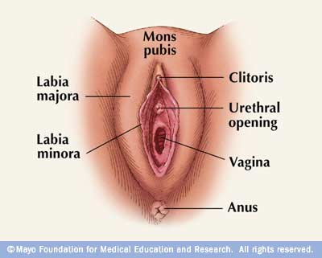
Vulva –
It is the term given to the female external genitalia.
Parts of the vulva –
Labium majora – two prominent hair bearing folds.
Mons pubis – perineum. Meet in the midline. Equivalent to male scrotum.
Labium minora - two folds lies medial to the labium majora as lips of soft skin. Meets posteriorly in the midline as a sharp fold (fourachette). Anteriorly splits to enclose the clitoris.

Slide 12
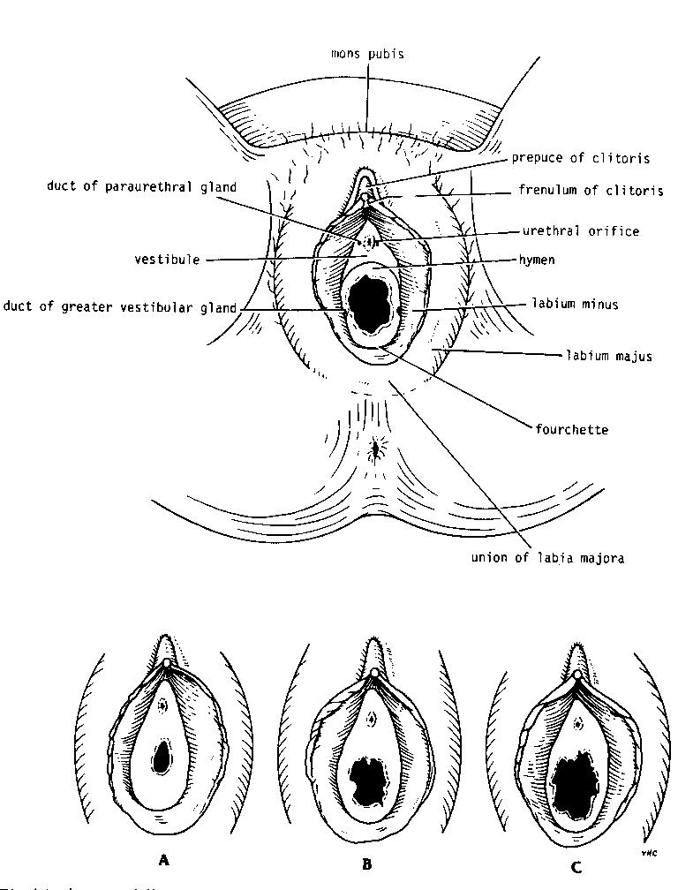
Vestibule – area enclosed by the labium minora. contains the clitoris, urethral orifice and vaginal orifice.
The vaginal orifice is guarded by a thin mucosal fold which is the hymen.
Hymen shape can vary.
Some times can be an imperforated hymen

Slide 13
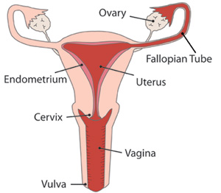
Uterus-
Develops from paramesonephric duct
Pear shape organ. 7.5cm in length.
Three parts – fundus, body and cervix.
Body narrows and becomes the isthmus, before becoming cervix.
Cervix communicate with body at internal os and with the vagina at the external os.

Slide 14
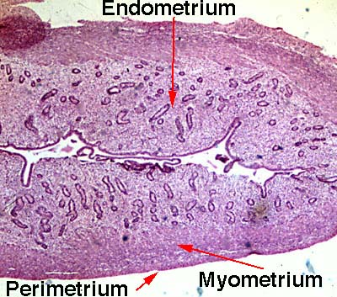
Structure-
Covered by the peritoneum except anteriorly below the level of internal os. Myometrium is made up of smooth muscles covered by connective tissue.
Mucous membrane lining the body is the endometrium. Endometrium is lined by columnar epithelium. Arteries and glands present.

Slide 15
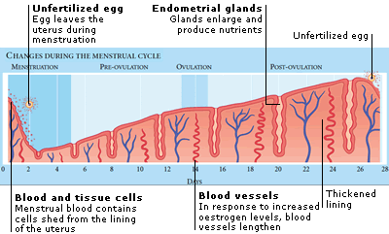
Features During menstrual cycle

Slide 16
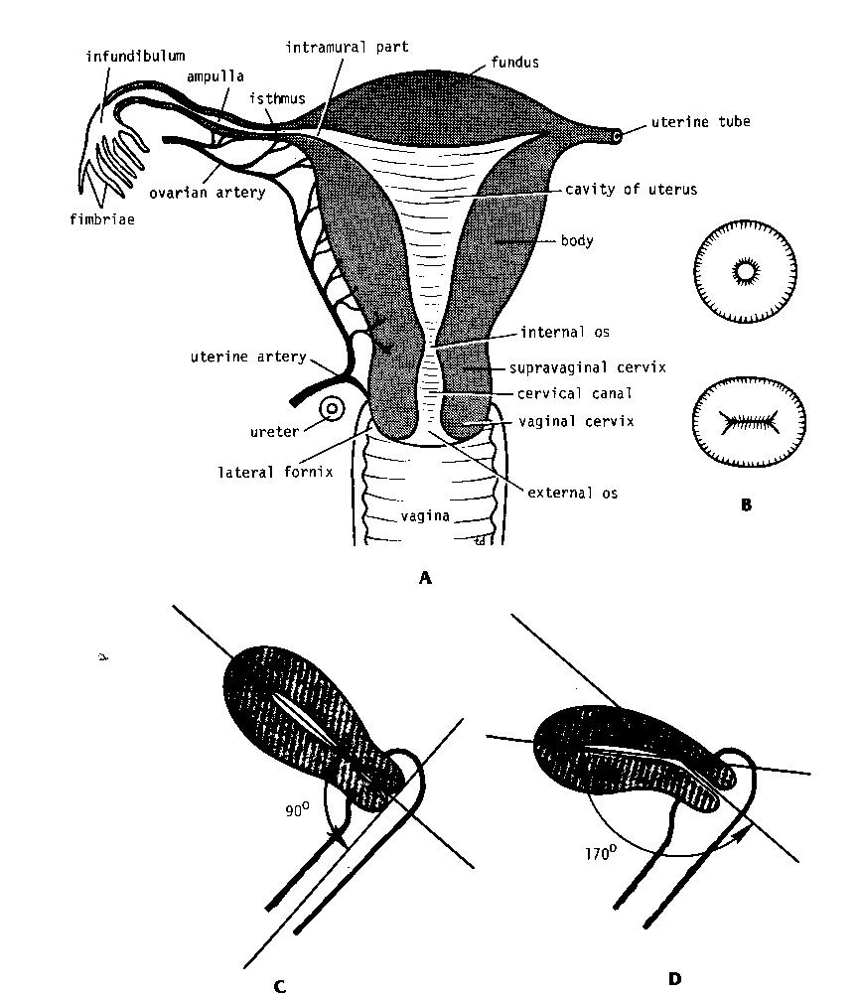
Antiversion angle
The angle between the axis of uterus and the axis of vagina.
Antiflexion angle
The angle between the axis of the uterus and the axis of the cervix.

Slide 17
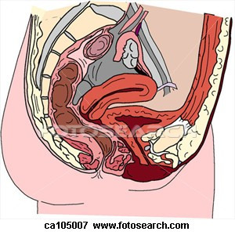
Relations-
Anteriorly – utero vesicle pouch, bladder
Posteriorly – recto uterine pouch, coils of ileum, pelvic colon.
Laterally – broad ligament, uterine artery, uterine vein, ureter.
.

Slide 18
Arterial supply- Uterine artery from internal iliac and ovarian artery from abdominal aorta.
Venous drainage- uterine vein drains to internal iliac vein and some drain into ovarian veins
Lymphatic drainage-
Fundus – para aortic nodes,
Body – internal and external iliac nodes, superficial inguinal nodes.
Nerve supply – branches from pelvic plexus.

Slide 19
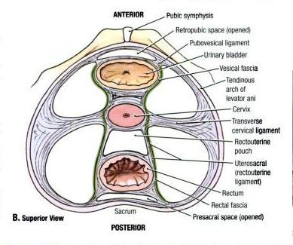
Supports of the uterus-
Levator ani muscle and perineal body.
Transverse cervical ligament – Lateral pelvic walls to cervix and vagina.
Pubo cervical ligament – from cervix to the posterior surface of pubis.
Utero sacral – from sacrum to the cervix and upper end of the vagina.
Round ligament – from the supero lateral angle of uterus to the labium majora. Helps to keep uterus antiverted and antiflexed.

Slide 20
Vagina-
Develops from paramesonephric duct and sinovaginal bulbs
Surrounds uterine cervix. Passes through the pelvic floor to open into the vestbule of vulva.
Anterior wall 7.5 cm. Posterior wall 10cm.
Has 3 fornices- anterior, posterior and lateral.
Relations-
Anterior- bladder and urethra.
Posterior- pouch of douglas,rectum, anal canal.
Laterally – levatorani, pelvic fascia and ureter.
Arterial – uterine, vaginal, internal pudendal and middle rectal.
Venous drainage – internal iliac veins.

Slide 21
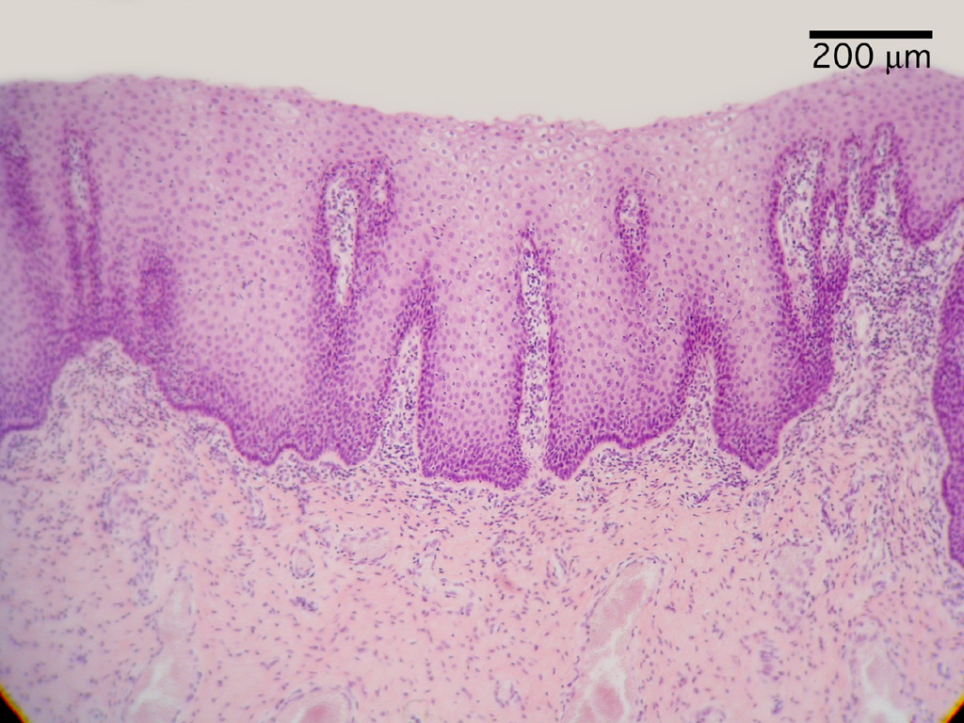
Lymphatic drainage of vagina-
Upper 1/3 – internal and external iliac nodes
Middle 1/3- internal iliac nodes.
Lower1/3- superficial inguinal nodes.
Structure-
Lined by stratified squamous epithelium. No glands. Lubricated by cervical mucus. In nulliparous women the wall is rugose. After child birth it becomes smoother.
In old age vagina shrinks in length and diameter. Fornices tend to disappear.

Slide 22
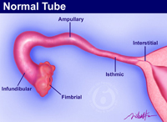
Fallopian tubes –
Develops from paramesonephric duct
Two on either sides. Approximately 10cm long. Lies on free edge of broad ligament. Opens into cornu of uterus. four parts.
Infundibulum – Extends beyond the broad ligament. Opens into the peritoneal cavity. Its mouth is fimbriated. Overlies the ovary. One long fimbria adheres to it.
Ampulla – wide, thin walled, tortuous.
Isthmus – narrow, thick walled and straight.
Interstitial part – pierces the uterine wall.
It is covered by the peritoneum except the interstitial part.

Slide 23
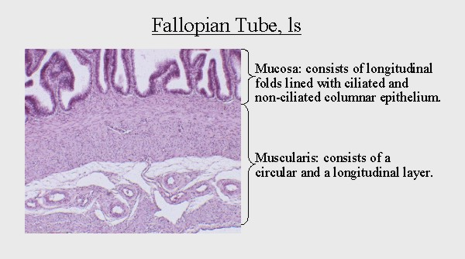
Mucosa – columnar ciliated cells, thrown into numerous folds.
Muscle layer –
Inner circular and outer longitudinal.
Blood supply –
ovarian and uterine.
Clinical importance –
potential pathway for infection to spread into the peritoneum. A site for ectopic pregnancy. Ampullary commonest. Interstitial rarest. If occurs in the isthmus – can enter the peritoneum and the broad ligament

Slide 24
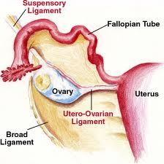
Ovary –
Almond shape. Approximately 4cm long.
Attached to the back of the broad ligament by the mesoovarium.
From ovary to cornu of the uterus (ovarian ligament).
Ovary to lateral pelvic wall (infundibulo pelvic ligament) Ovarian vessels and lymphatics pass along it.
Lies close to external iliac vessels and ureter (front) internal iliac vessels (behind).

Slide 25
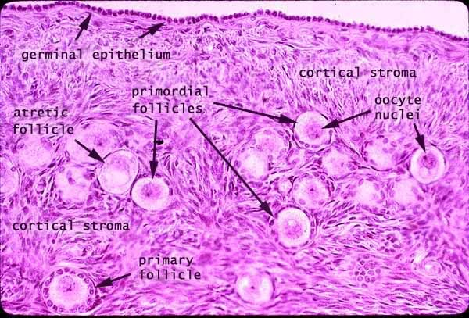
Develops from the genital ridge. Descends into the pelvis.
Arterial supply – ovarian artery – abdominal aorta.
Venous drainage – right side IVC, left side left renal vein.
Lymphatics – aortic nodes.
Nerve supply – aortic plexus (T10).
Structure – no peritoneal covering, Has a fibrous capsule (tunica albuginea).
Has a cortex and a medulla.
Several follicles in various stages of development are present

